Slide 1
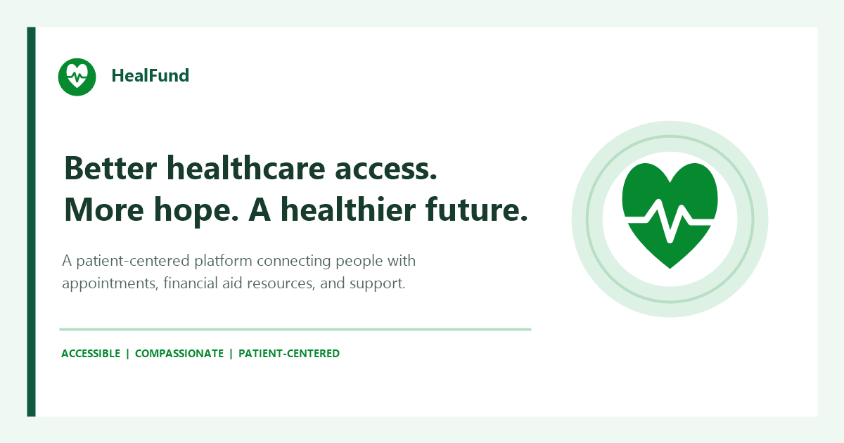
HEALFUND
Better healthcare
access. More hope.
A patient-centered platform connecting people with appointments, financial aid resources, and support.
PROJECT PRESENTATION FOR 25 OCTOBER 2026
HEALFUND | Better healthcare access. More hope.
01

Slide 2
Introduction to HealFund
A unified digital platform for navigating healthcare support.
HealFund brings patients, families, and healthcare teams together through a trusted online experience. It brings essential steps into one place, helping people move from seeking care to managing follow-up with greater clarity.
Patient-centered
Designed around the healthcare journey.
Connected workflows
Care access, support, and coordination.
Accessible information
Clear paths to services and assistance.
HEALFUND | Better healthcare access. More hope.
02

Slide 3
Statement of the Problem
People experience healthcare support as disconnected steps.
Fragmented access
Coordination gaps
Trust and visibility
Appointments, files, and support can be spread across separate channels.
Patients may be unsure where to go next.
Staff need a clearer shared view of cases and follow-up.
Manual coordination can slow the journey.
Financial assistance needs clear information and responsible oversight.
People need confidence in the process.
HEALFUND | Better healthcare access. More hope.
03

Slide 4
Objectives
A practical platform for patients, healthcare teams, and administrators.
Improve access
Support coordination
Bring appointments, support information, and patient services into a clear digital experience.
Help healthcare teams manage patient workflows, documents, and follow-up.
Enable oversight
Build trust
Give administrators tools for role-based user management and operational visibility.
Make financial assistance and support workflows easier to understand and monitor.
HEALFUND | Better healthcare access. More hope.
04

Slide 5
Key Features
Core capabilities across the patient and admin portals.
Patient portal
Admin and staff
Financial assistance
Appointment booking and management
Profile and account controls
Medical files and patient support
Queue and follow-up information
Multilingual interface
Patient account management
Role-based access and controls
Hospital and workflow oversight
Queue and appointment coordination
Support communication
Financial aid information
Donation and case visibility
Verification-oriented workflows
Support status and progress context
HEALFUND | Better healthcare access. More hope.
05

Slide 6
Platform Roles
Separate views make each workflow clearer.
Patients and families
Healthcare teams
Administrators
Find relevant services
Manage appointments and records
Access support and follow-up
Coordinate patient workflows
Review relevant case information
Support verification and follow-up
Manage user access and roles
Oversee operations
Support consistent platform workflows
HEALFUND | Better healthcare access. More hope.
06

Slide 7
Scope and Considerations
A digital workflow supports care teams; it does not replace clinical judgment.
Platform scope
Important considerations
Patient-facing services and support information
Administrative and staff workflow tools
Account access, appointments, queues, and records
Financial assistance and donation visibility
Service availability depends on deployment and connectivity.
Verification quality depends on operational processes.
Payment workflows require provider configuration and reconciliation.
Privacy, consent, access, and retention need ongoing governance.
HEALFUND | Better healthcare access. More hope.
07

Slide 8
Technology and Integration
A web platform with distinct user experiences and a shared API.
Frontend
Backend
Data
Integrations
React
Vite
Patient and admin portals
Node.js
Express REST API
JWT-based access
MongoDB
Mongoose models
Validated records
Chapa-hosted checkout
Email configuration
Render deployment
Patient portal: healfund.onrender.com | LinkedIn: linkedin.com/in/heal-fund
HEALFUND | Better healthcare access. More hope.
08

Slide 9
User Experience and Trust
Designed to make important actions easier to understand.
Clear account flows
Responsible data handling
Specific sign-in feedback
Patient password management
Account actions with explicit confirmation
Role-aware administration
Protected routes for authorized roles
Account removal separated from retained service records where required
Secure configuration is needed for production use
Ongoing testing and operational monitoring
HEALFUND | Better healthcare access. More hope.
09

Slide 10
Conclusion
HealFund brings care access and healthcare support closer together.
A healthier future starts with a clearer path to care.
Connect with HealFund
healfund.onrender.com
linkedin.com/in/heal-fund
HealFund connects patient services, healthcare workflows, and financial assistance in one patient-centered platform?helping people and teams coordinate the next step with more confidence.
HEALFUND ACCESSIBLE COMPASSIONATE PATIENT-CENTERED
HEALFUND | Better healthcare access. More hope.
10

